Slide 1
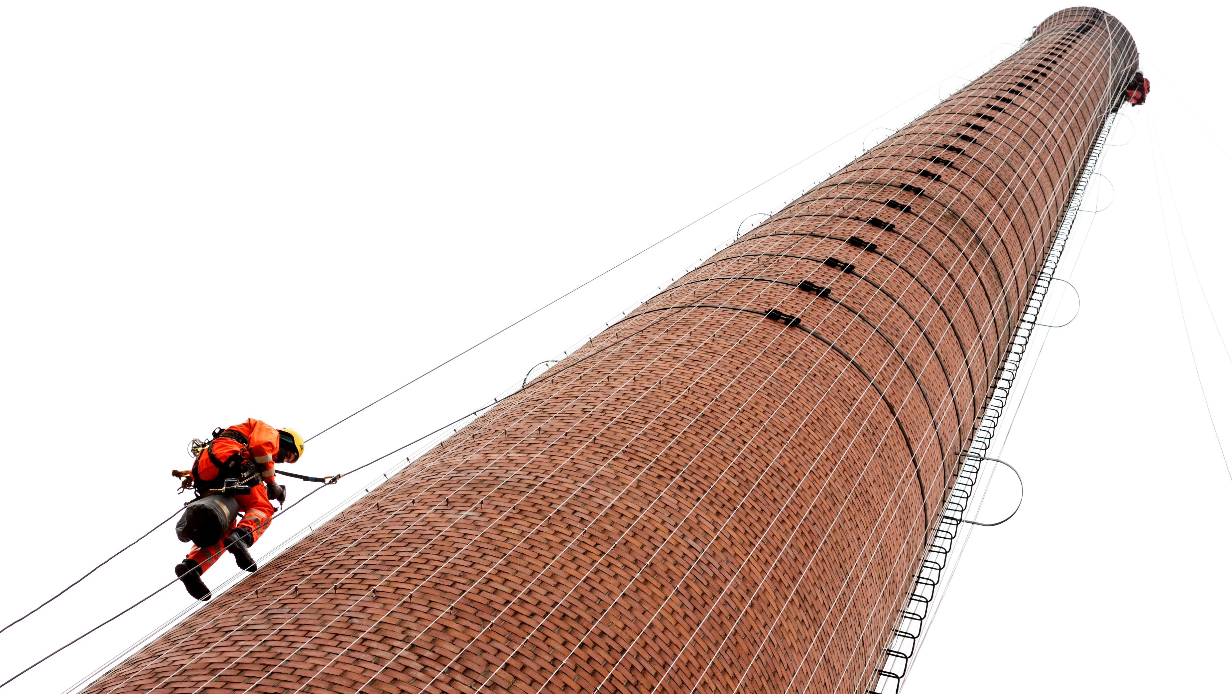

Sharing your data on 4TU.ResearchData

Slide 2
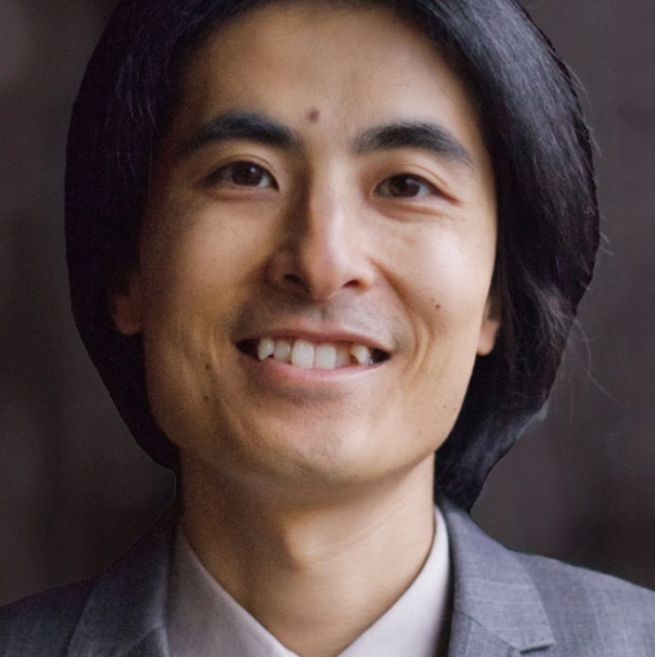
Who is Nami?
Data Steward
Nami Sunami
n.sunami@tue.nl

Slide 3


A Data Steward can help with …
Responsible Science
Privacy & GDPR
Agreements
Ethical Review Board (ERB) applications
Open Science & RDM
FAIR Data
Sharing
Sustainable Workflow

Slide 4

Open Science & RDM

Slide 5
TU/e Open Science Initiatives

Slide 6

Register: edu.nl/8wd8g Contact: openscience@tue.nl
Notes:
On 17 September we are organizing a university-wide event “Everything you wanted to know about Open Science”. Make sure to register and come!
Why should you attend?
• Gain insights into Open Science and what it means for you • Experience inspiring examples of Open Science from the TU/e academic community
• Co-design the Open Science agenda of the TU/e

Slide 7




Join
sites.google.com/view/osceindhoven
twitter.com/osceindhoven
openscience@tue.nl
Notes:
If you would like to join a community of like-minded people at TU/e – you are welcome to become a member of the OS community Eindhoven.
It’s a space where you can exchange experiences with fellow researchers, learn something new and/or share your knowledge with others.
Starting from the new academic year, we are going to have budget from NWO which will help the community to develop and grow and you can be part of it.

Slide 8
Uploadiing data to 4TU.ResearchData

Slide 9
Why publish your data?

Slide 10
Publishing your data makes your research visible and usable to others, including you in the future

Slide 11
Your dataset deserves a DOI.
Notes:
Get your dataset a DOI it deserves.

Slide 12


Today’s Goal is to submit a dataset on 4TU.ResearchData
Your own dataset
Example dataset edu.nl/pg33f
Klapwijk, E., Sunami, N., Mania, J., Lushaj, B., & Volkova, A. (2023). EUR publication package example [Data set]. Zenodo. https://doi.org/10.5281/zenodo.7956600
Notes:
Example dataset is from SAFI Study: Studying African Farmer-Led Irrigation

Slide 13
4TU.ResearchData Deposit Workflow
Data Steward can help in between
4TU.ResearchData
Researcher
Submits a package
Reviews the metadata
Revise the package
Resubmits
Make the package visible to public

Slide 14
The whole game today
Login to 4TU.RD
Upload data amd complete the form
Submit / save draft
For a test dataset, use the sandbox (next.data.4tu.nl)

Slide 15
Demo

Slide 16
FAQs

Slide 17

How much data can I deposit?
50 GB/year
By default, as a TU/e user / depositor
More space available by request
https://data.4tu.nl/info/en/use/publish-cite/our-users
Notes:
For more information about costs, see:
https://data.4tu.nl/info/en/use/publish-cite/our-users

Slide 18

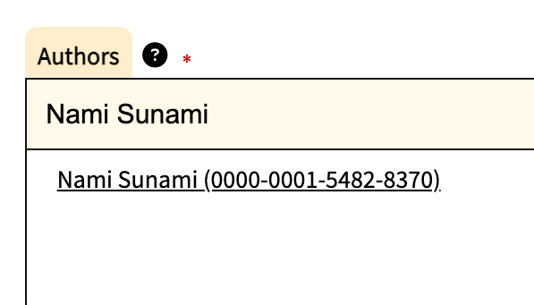
Depositor or Author?
Depositor
The person who uploads dataset.
One dataset has one depositor.
First 50 GB per year is free
Author
The contributor to the dataset.
One dataset can have many authors

Slide 19


How do I choose a license?
Recommended licenses
Data, documentation, …
Code
CC-BY 4.0
MIT
Note: If the research project is under agreements, you may need to follow the terms. Consult a Data Steward.

Slide 20


Let’s deposit a dataset
Your own data
Test data
edu.nl/pg33f
data.4tu.nl
next.data.4tu.nl

Slide 21
What happens after I submit the package?
Metadata review by 4TU.RD
Revise the package
Published
https://data.4tu.nl/info/en/use/publish-cite/after-uploading
https://data.4tu.nl/s/documents/Metadata_review_guidelines_June_2021.pdf
Notes:
Metadata reviewers use guidelines:
https://data.4tu.nl/s/documents/Metadata_review_guidelines_June_2021.pdf

Slide 22
Questions?
Thoughts to share?
rdmsupport@tue.nl

Slide 23
Footnotes
Research Data Management (RDM) refers to the process in which you collect, analyze, store, share, archive and publish research data, to satisfy the needs of current and future data users (including you in the future)
Icons in this slide deck are from Lucide, open-source icon library (https://lucide.dev/icons/rainbow)
This slide deck is licensed under CC BY 4.0
This slide deck was inspired by the work of Floor Luub who previously gave a similar workshop. I (Nami) would like to thank her for pioneering the work and sharing materials with me.

